Slide 1
Presented By: Pritilata Biswas (1103017) Sumaia Afrin Prity (1103057) Parvez Abedin Siddique (1103094) Department of CSE BAIUST
Bangladesh Army International University Of Science And Technology
Tentative Title : Analysis of connected component for Bengali Character Recognition
Supervised By:
Arifa Islam Champa Lecturer Department of CSE BAIUST

Slide 2
OVERVIEW
Introduction
Motivation
Background study
Objective
Methodology
Expected outcome
Conclusion

Slide 3
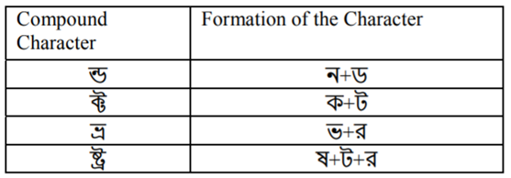
INTRODUCTION
Fifth most written script
Topologically connected
Used for building a good OCR
Figure 1: Some compound characters in Bengali script [1]

Slide 4
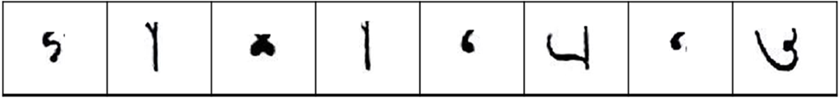
MOTIVATION
Printed text OCR have a huge success
Methods for handwritten OCR
Using HPP and VPP
Using DFS
For multi font
Major problem - Matra line removing
Figure 2: Characters splits into two parts [1]

Slide 5
BACKGROUND STUDY
In T. Zahan, M.R. Selim, M.S. Rahman, M.Z. Iqbal, (2018). “Connected Component Analysis Based Two Zone Approach for Bangla Character Segmentation.” pp - 1-4. 10.1109/ICBSLP.2018.8554684. [1],
Step 1: Processing
Step 2: Line Segmentation
Step 3: Word Segmentation
Step 4: Character Segmentation
Inadequacy : Main problem occurs in step 4 after removing matra line.

Slide 6
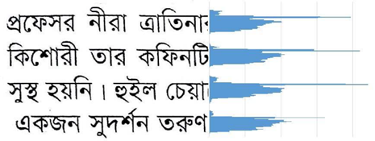
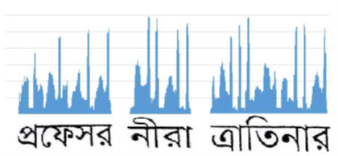
BACKGROUND STUDY
HPP – Horizontal Profile Projection
Figure 3: Line segmentation process [1]
VPP – Vertical Profile Projection
Figure 4: Word segmentation [1]

Slide 7



BACKGROUND STUDY
(a) (b) (c)
Figure 5: (a) Input image, (b) After erosion, (c) After dilation [4]

Slide 8


BACKGROUND STUDY
Opening and Closing:
Figure 6: Opening [5] Figure 7: Closing [6]

Slide 9
OBJECTIVE
To enhance Bengali OCR with connected component analysis
To improvise Profile Projection with Closing operations
Implement Closing for Profile Projection with Dilation and Erosion
Comparative analysis between existing and proposed method

Slide 10



8
METHODOLOGY
Step 1: Input Processing
Apply Grey Scale filter
Apply Bilateral filter
Apply Bit Plane slicing
Skew Angle correction
Input RGB Image
Steps 3: Word Segmentation
Apply VPP
Step 2: Line Segmentation
Apply HPP
Apply HPP
Steps 4: Character segmentation
Analyze connected component
Matra line detection
Apply Closing+Dilation
Figure 8: The proposed methodology

Slide 11
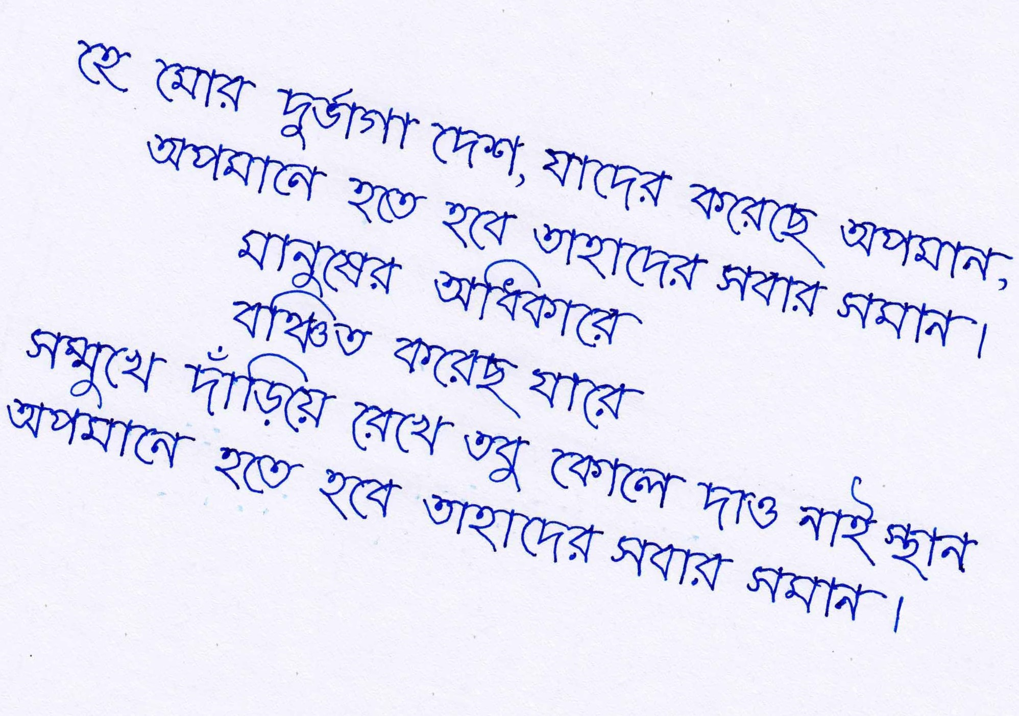
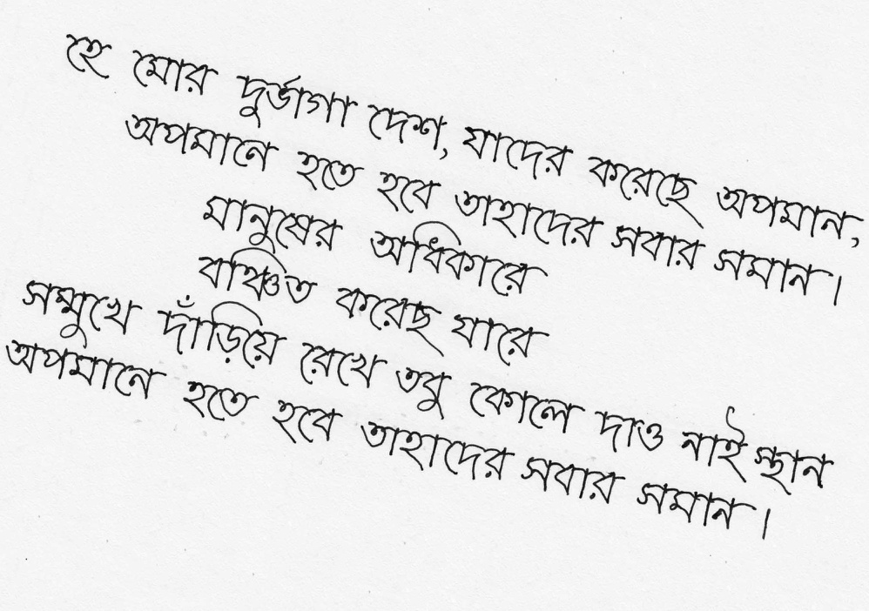

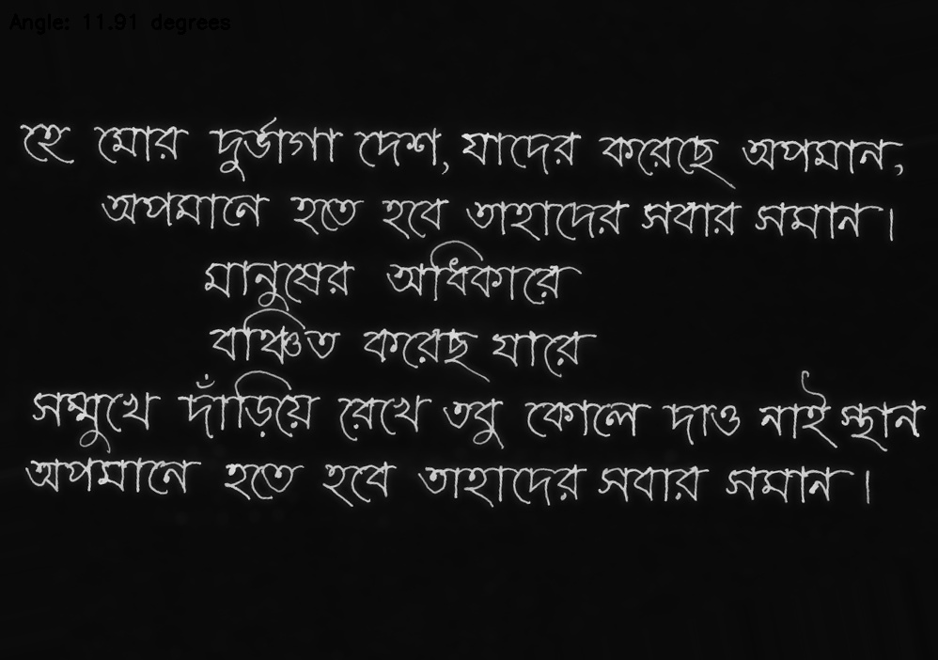
IMPLEMENTATION
(a)
(b)
(c)
(d)
Figure 10: (a) input image, (b) applying grey scale filter, (c) applying bilateral filter, (d) skew angle correction

Slide 12

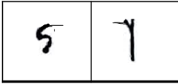
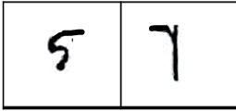
EXPECTED OUTPUT
(a) (b) (c)
Figure 9: (a) Current output which occurs problem [1]
(b) After closing expected output [6]
(c) Dilation on (b) [6]

Slide 13
CONCLUSION
Main challenge
Define the structuring element properly.
Limitations
Might increase the cost of algorithm
Connected component might not be regenerated as per expected output

Slide 14
REFERENCES
[1]. T. Zahan, M.R. Selim, M.S. Rahman, M.Z. Iqbal, (2018). “Connected Component Analysis Based Two Zone Approach for Bangla Character Segmentation.” pp - 1-4. 10.1109/ICBSLP.2018.8554684.
[2]. M. A. Obaida, T. K. Roy, M. A. Horaira and M. J. Hossain, “Skew Correction Function of OCR: Stroke-Whitespace based Algorithmic Approach,” International Journal of Computer Applications 28(8):7-12, August 2011.

Slide 15
REFERENCES
[3]. S. S. Goswami, “Identification of Matra Region and Overlapping Characters for OCR of Printed Bengali Scripts,” Intelligent Computing and Information Science, Volume 135 of the series Communications in Computer and Information Science, pp. 606-612, 2011
[4].https://docs.opencv.org/2.4/doc/tutorials/imgproc/erosion_dilatation/erosion_dilatation.html
[5]. https://homepages.inf.ed.ac.uk/rbf/HIPR2/open.html
[6]. https://homepages.inf.ed.ac.uk/rbf/HIPR2/close.html

Slide 16
THANK YOU!

